Slide 1

Artificial Intelligence – FULL Stack- [Course]
It is not about Theory, it is 20% Theory and 80% Practical –Technical/Development/Programming [Mostly Python based]
By the end of this course, the trainees should gain the following competencies:
Understanding of core concepts of artificial intelligence and machine learning
State of the art machine learning techniques
Hands-on exposure to exploratory data analysis Practical exposure to model design, evaluation
Familiarity with tools and libraries such as numpy, pandas, scikit learn, tensorflow, and keras
About Instructor:
Shahzad - Software Fractional Strategy Consultant - 25+ Years of Experience in Software Industry - with clients in across North America and Europe, with focus on:
Cloud/SaaS- Software as Service
Artificial Intelligence & Generative AI & LLM
Machine Learning & Deep learning & Neural Networks
Data Analytics, Business Intelligence and Data Science
CRM-ERP-CMS – Development, Implementation and Consulting
Ecommerce Development - Platform and Services
About Institute: NexSkill is Pakistan's leading IT training institute, providing the best IT training in Pakistan. NexSkill offers a variety of professional learning platforms to its students.
https://www.nexskill.com/

Slide 2
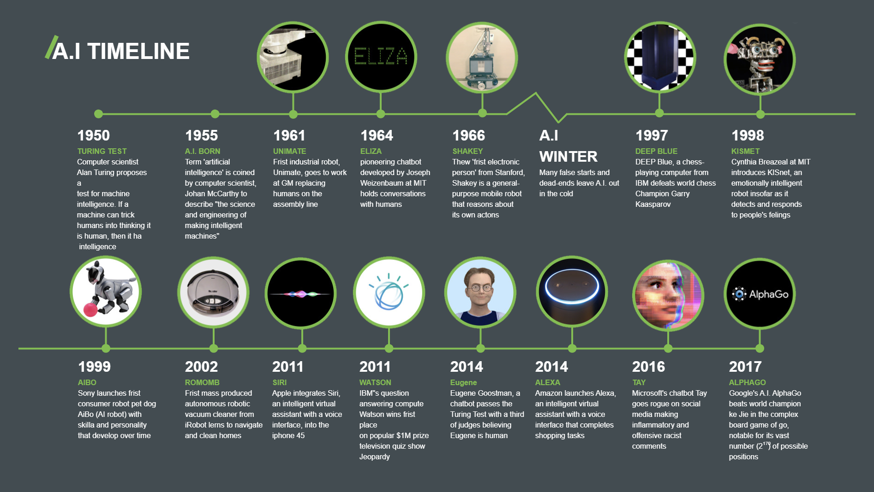
Artificial Intelligence (Machine Learning & Deep Learning) -Timelines

Slide 3
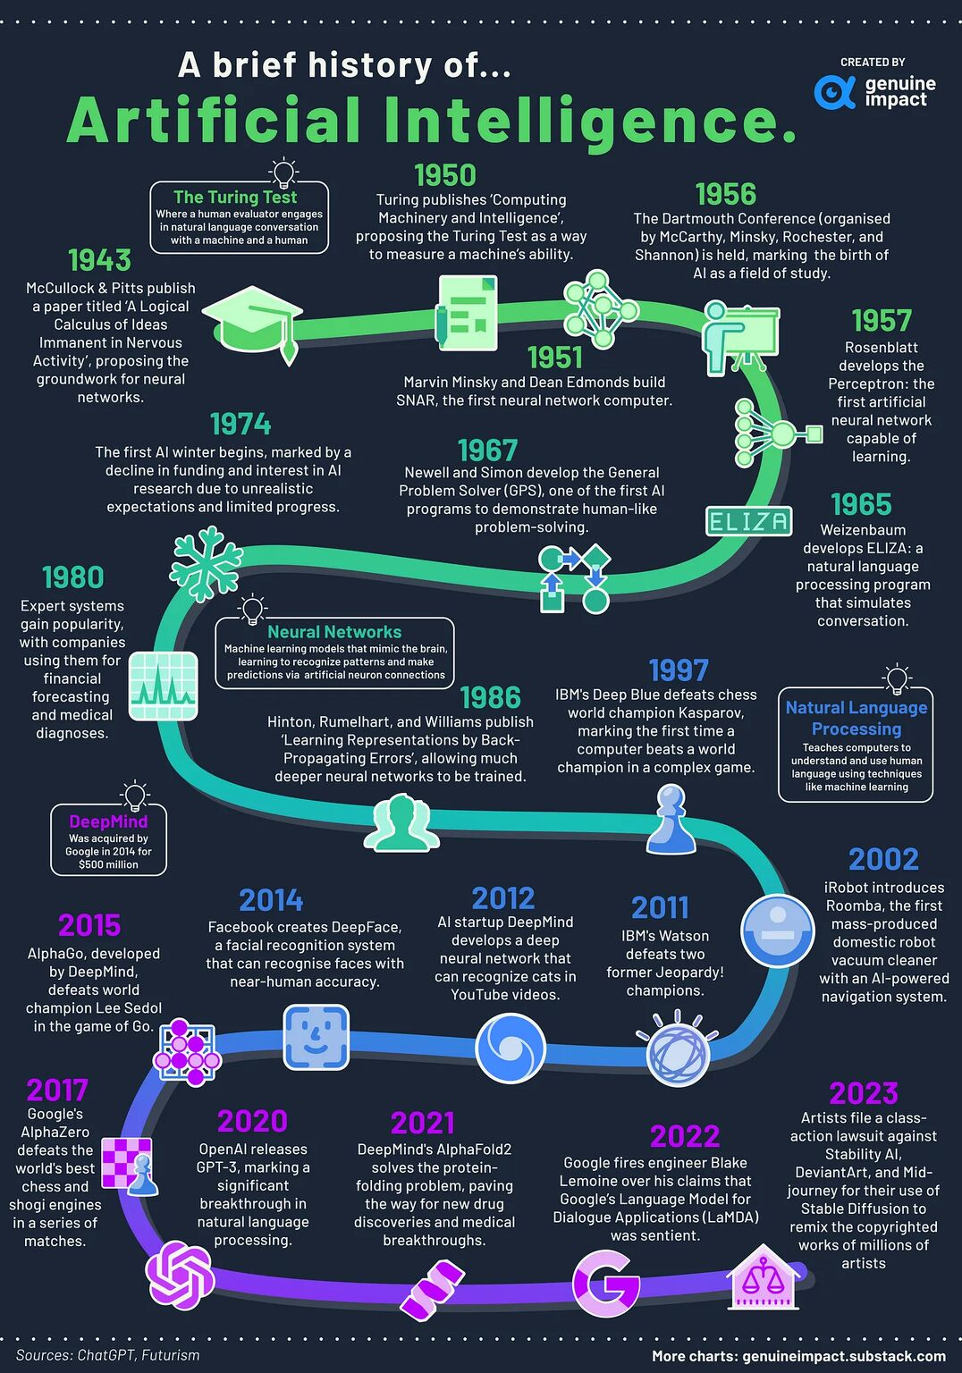
Artificial Intelligence
(Machine Learning & Deep Learning) –
Timelines – 2nd View

Slide 4

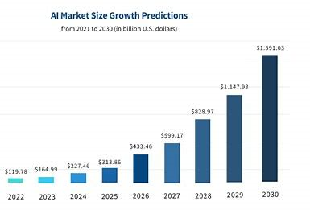
Why AI is so important Today-What is happening
Market Growth: The global AI software market is expected to continue its rapid growth. According to various market research reports, the AI software market was valued at approximately $136.55 billion in 2023 and is expected to grow at a compound annual growth rate (CAGR) of around 37-40% from 2024 to 2030. This would bring the market size to over $1 trillion by 2030.
[ Source: Statista - https://www.statista.com ]
Development Team formation : Old style Formation vs New style Formation
2 front end developer + 2 backend developer + 1 QA engineer + Team Lead
[Old style Formation ]
2 front end developer + 2 backend developer + 2 AI/ML Engineer + 1 QA + Team Lead
[New style Formation ]
-------------------
StarGate Initiative: The Stargate Project is a new company which intends to invest $500 billion over the next four years - initial equity funders in Stargate are SoftBank, OpenAI, Oracle, and MGX
https://openai.com/index/announcing-the-stargate-project/
https://fortune.com/2025/01/22/what-is-the-stargate-ai-project-trump-ellison-son-altman/
https://www.forbes.com/sites/emilsayegh/2025/01/22/stargate-ai-project-the-500-billion-gamble-to-dominate-the-future/

Slide 5
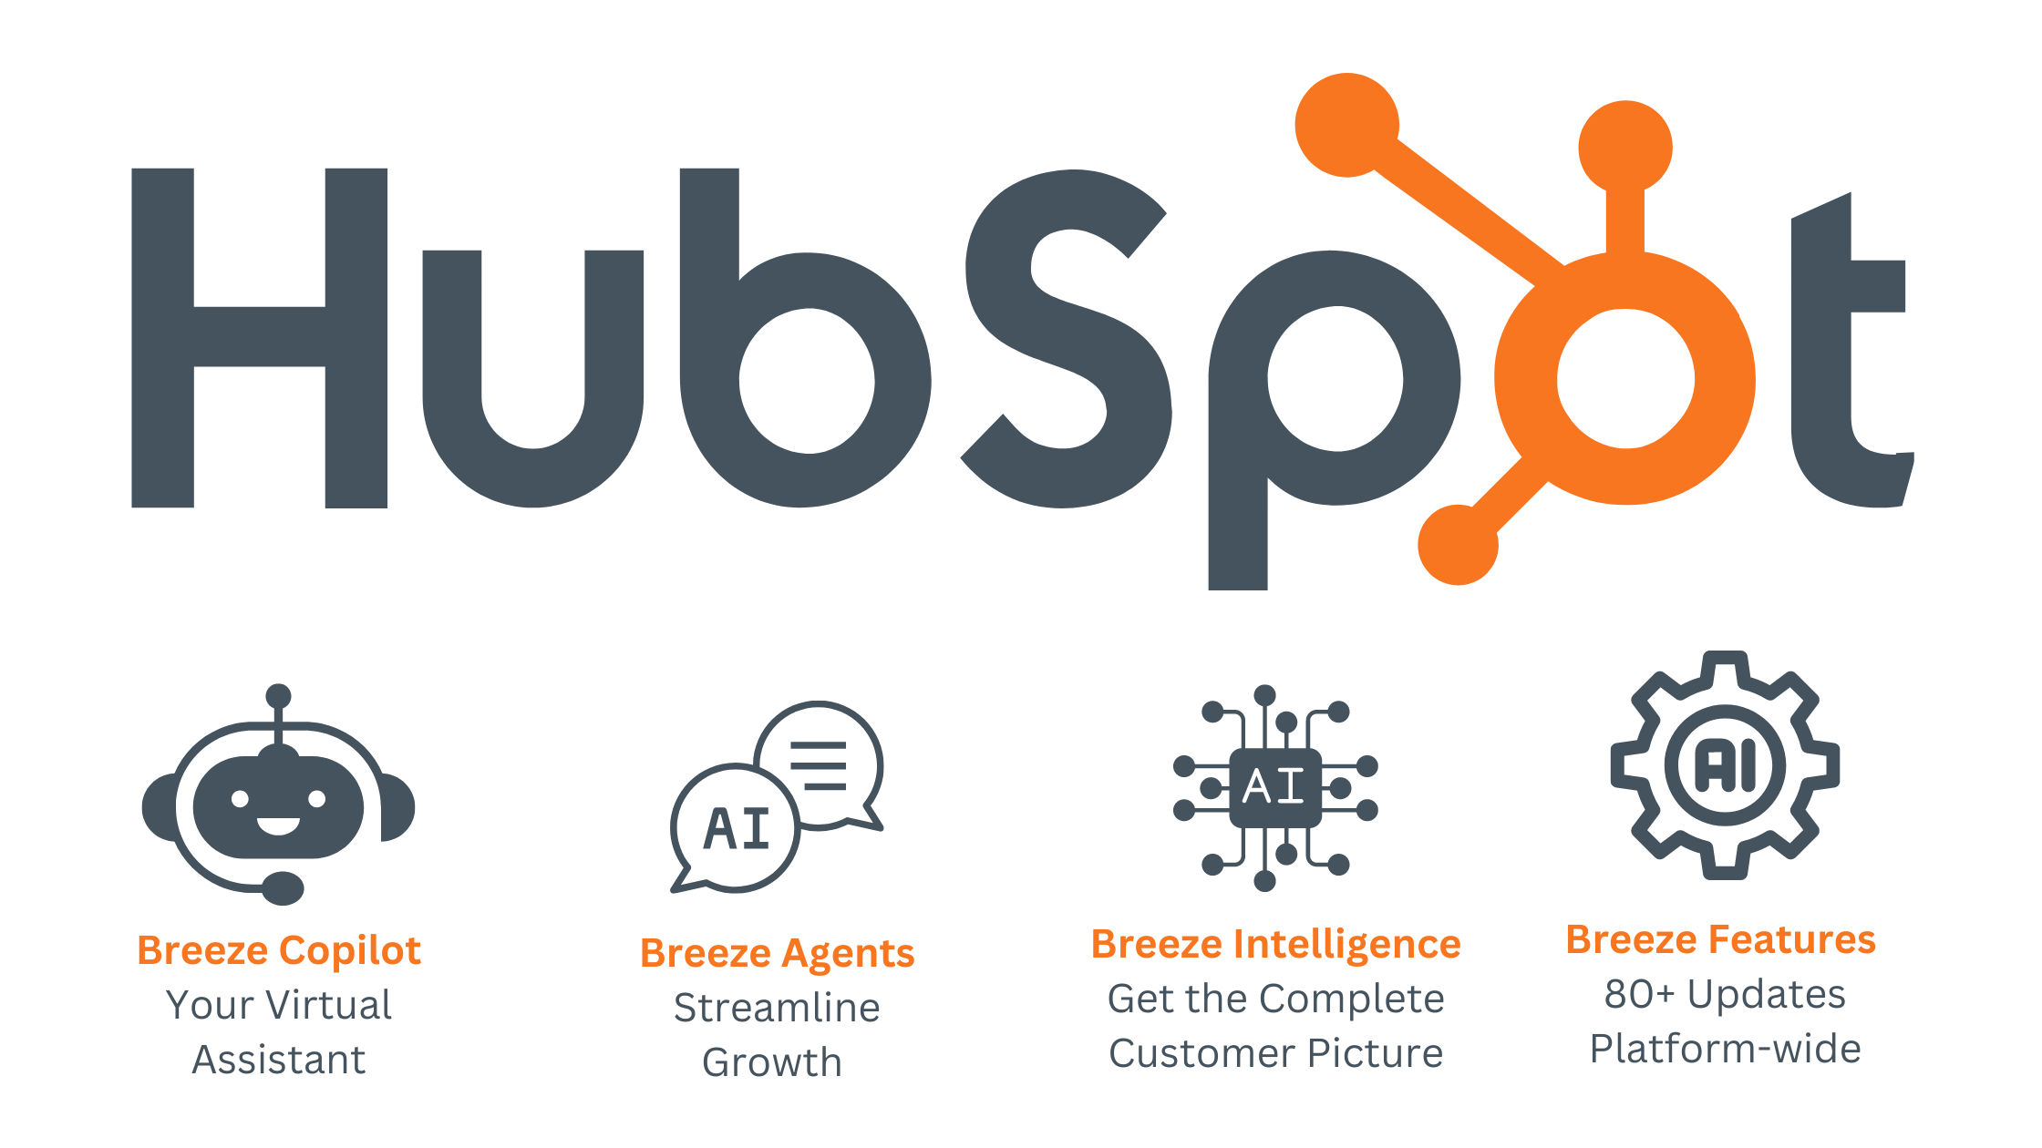
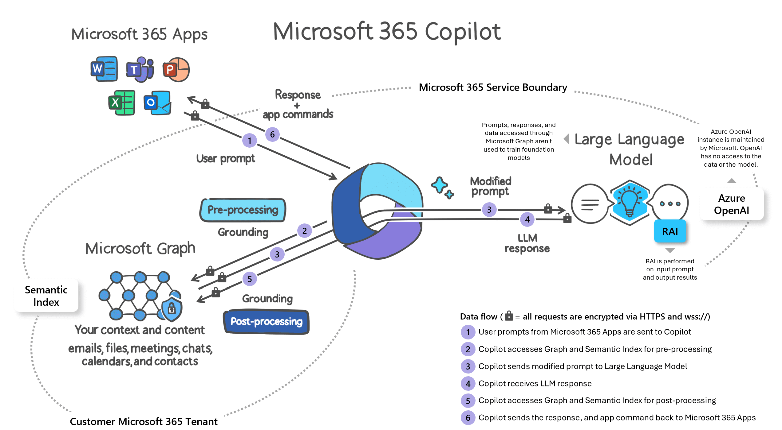
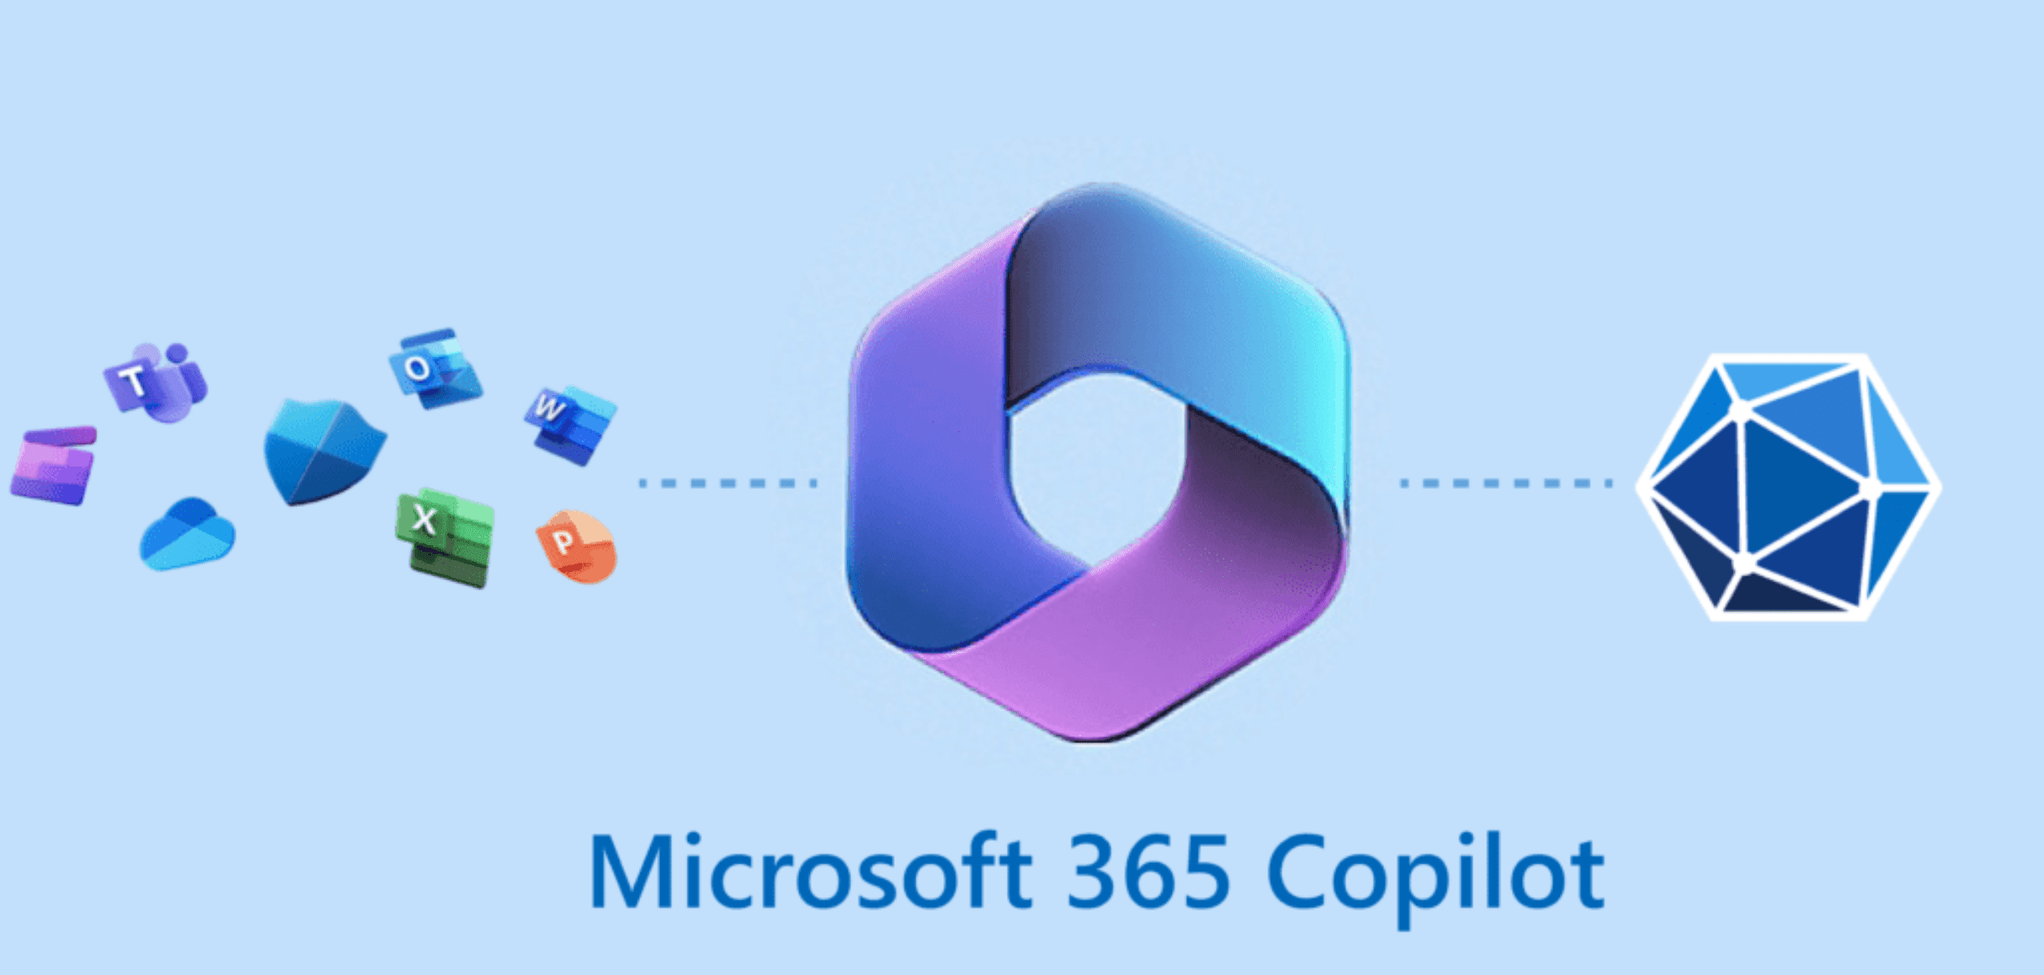
AI Everywhere –
Every CMS/CRM/ERP/E-commerce - solution , Every product or Every Mobile App
or Every web app - AI Everywhere
Applied AI in Industry:
Exercise: Create a account for HubSpot – explore breeze / co-pilot features
https://www.hubspot.com/products/artificial-intelligence
Exercise: Create a account for Microsoft 365 – explore
co-pilot features
https://www.microsoft.com/en-us/microsoft-365/copilot

Slide 6
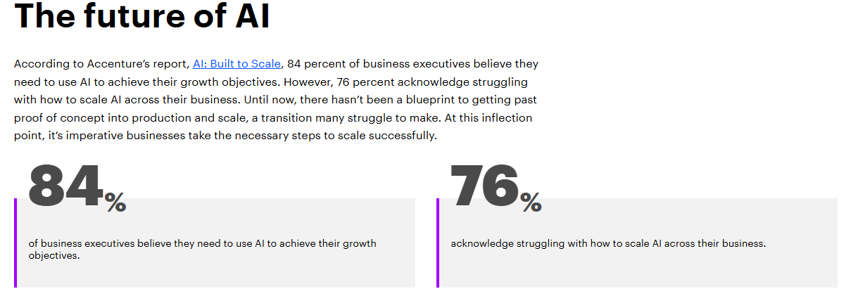

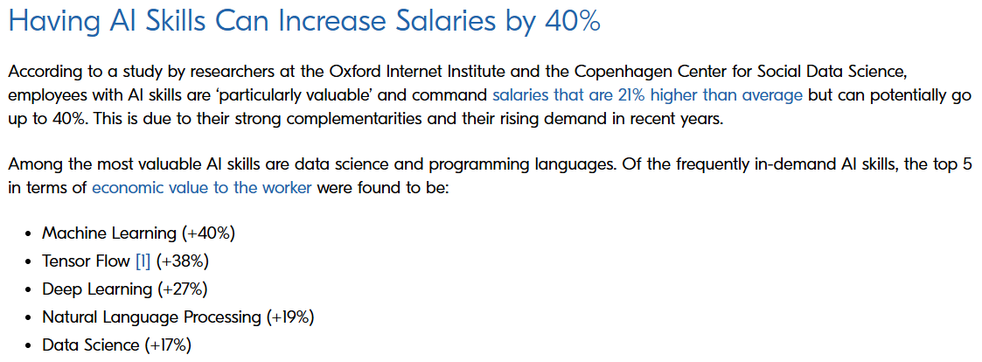




Which skills are in demand
https://www.berlin-international.de/en/magazine/blog/why-having-ai-skills-is-important-in-todays-business-world/
https://www.forbes.com/sites/rachelwells/2024/06/10/3-in-demand-high-income-ai-skills-you-need-in-2024/
https://www.coursera.org/in/articles/ai-skills
AI Career Professional and Industry Trends
Accenture - Reference: https://www.accenture.com/cz-en/insights/consulting/gen-ai-reinventing-enterprise-models
https://www.accenture.com/cz-en/insights/artificial-intelligence-summary-index
Dynamics of AI Power economy and ecosystems - Reference:
https://onlinedegrees.sandiego.edu/ai-impact-on-job-market/
https://www.forbes.com/councils/forbestechcouncil/2025/01/10/how-artificial-intelligence-is-transforming-the-job-market-a-guide-to-adaptation-and-career-transformation/
https://mhrc.lums.edu.pk/how-susceptible-pakistans-job-market-ai
https://www.iedconline.org/clientuploads/EDRP%20Logos/AI_Impact_on_Labor_Markets.pdf

Slide 7

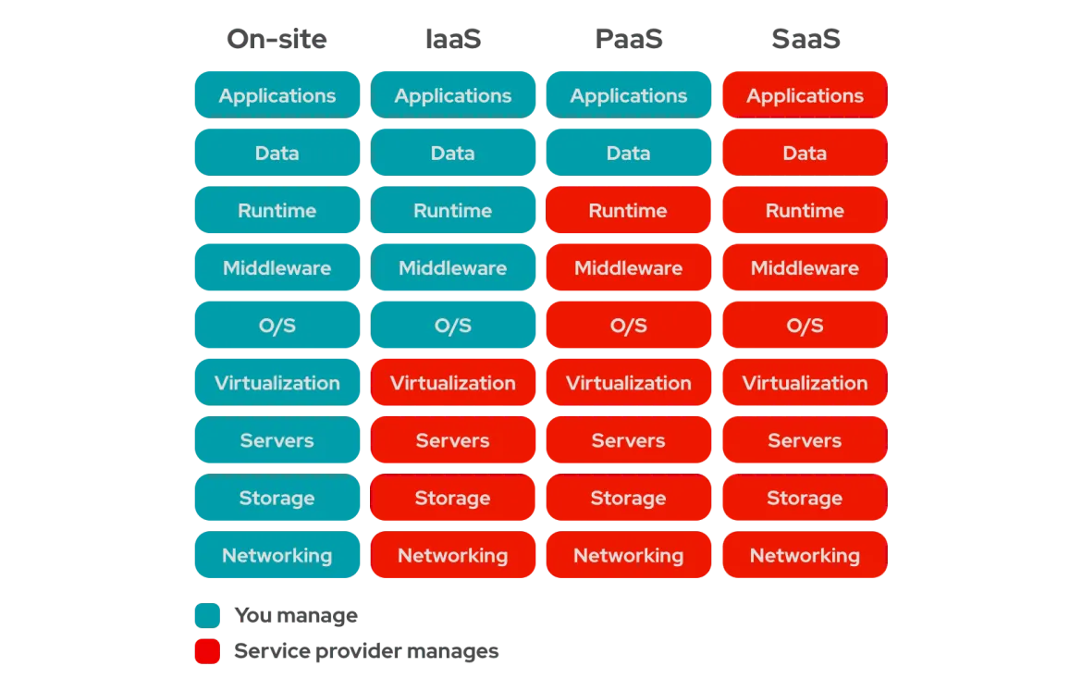
Modern SaaS AI Development Services
SaaS AI Development Platform : MicroSoft vs Google vs Amazon vs Oracle vs IBM
Microsoft – Azure AI Services:
https://azure.microsoft.com/en-us/solutions/ai/
Google AI services:
https://cloud.google.com/products/ai/
Amazon AI Services
https://aws.amazon.com/ai/services/
Oracle AI Services:
https://www.oracle.com/artificial-intelligence/ai-services/
IBM AI Services:
https://www.ibm.com/artificial-intelligence
Azure AI services – are included with training tasks.
References:
https://www.redhat.com/en/topics/cloud-computing/iaas-vs-paas-vs-saas
https://www.bmc.com/blogs/saas-vs-paas-vs-iaas-whats-the-difference-and-how-to-choose/

Slide 8
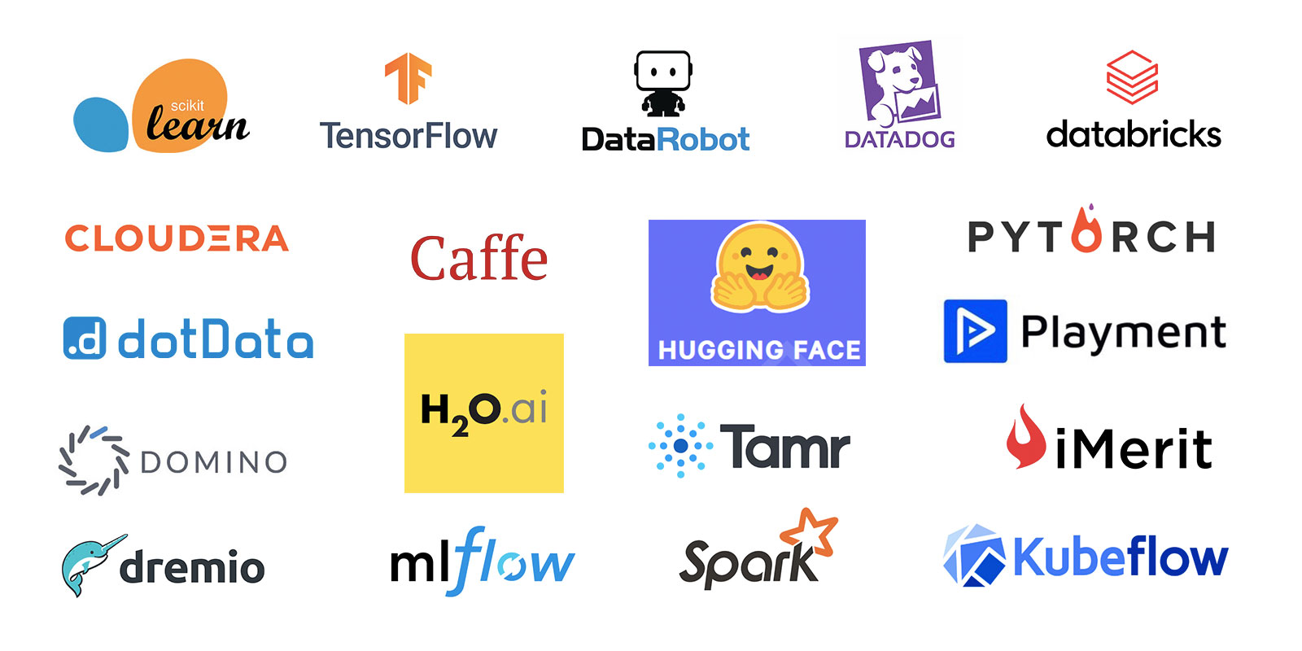
AI Standard alone Development Services,
Platform, Framework
References:
https://dagshub.com/blog/top-ai-frameworks-and-libraries/
https://www.splunk.com/en_us/blog/learn/ai-frameworks.html
https://www.geeksforgeeks.org/top-artificial-intelligence-frameworks/
https://5ly.co/blog/best-ai-frameworks/
https://clockwise.software/blog/artificial-intelligence-framework/

Slide 9
AI/ML/DL–Framework/Services[Covered in this Course]
Scikit-learn
Simple and efficient tools for predictive data analysis
Accessible to everybody, and reusable in various contexts
https://scikit-learn.org
TensorFlow
An end-to-end platform for machine learning
TensorFlow makes it easy to create ML models that can run in any
environment.
https://www.tensorflow.org/
Keras
Keras is a deep learning API designed for human beings, not machines. Keras
focuses on debugging speed, code elegance & conciseness, maintainability,
and deployability
https://keras.io/

Slide 10
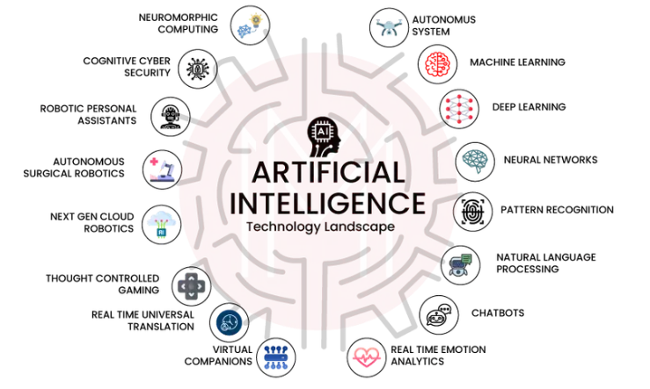
Basics - What is AI-Artificial Intelligence
Artificial intelligence (AI), the ability of a digital computer or computer-controlled robot to perform tasks commonly associated with intelligent beings. The term is frequently applied to the project of developing systems endowed with the intellectual processes characteristic of humans, such as the ability to reason, discover meaning, generalize, or learn from past experience
References:
https://cloud.google.com/learn/what-is-artificial-intelligence?hl=en
https://www.coursera.org/articles/what-is-artificial-intelligence
https://www.ibm.com/think/topics/artificial-intelligence

Slide 11
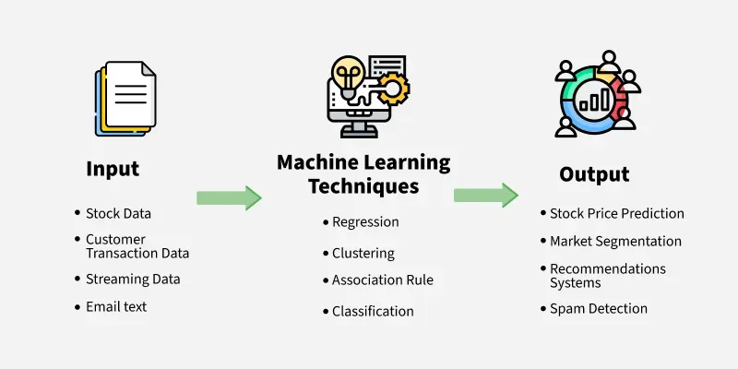
Basics - What is ML-Machine Learning
Machine Learning (ML) is a subset of Artificial Intelligence (AI) that enables computers to learn and improve from data without explicit programming, using algorithms to analyze data, identify patterns, and make predictions or decisions
References:
https://www.ibm.com/think/topics/machine-learning
https://www.spiceworks.com/tech/artificial-intelligence/articles/what-is-ml/
https://cloud.google.com/learn/artificial-intelligence-vs-machine-learning?hl=en

Slide 12
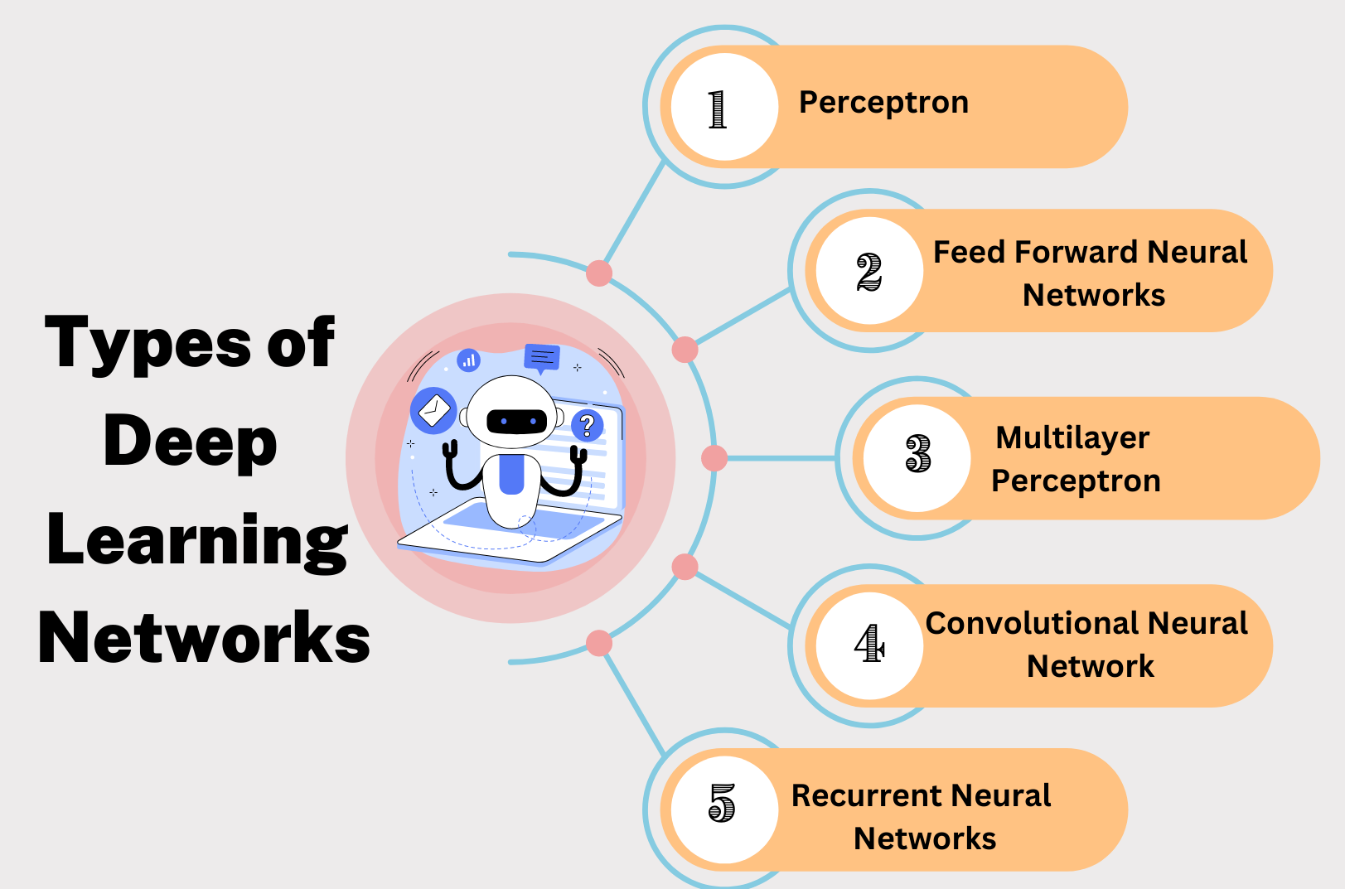
Basics - What is DL-Deep Learning
Deep learning is a subset of machine learning that focuses on utilizing neural networks to perform tasks such as classification, regression, and representation learning.
References:
https://aws.amazon.com/what-is/deep-learning/
https://www.ibm.com/think/topics/deep-learning
https://cloud.google.com/discover/what-is-deep-learning?hl=en

Slide 13
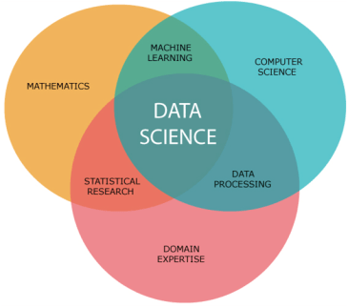
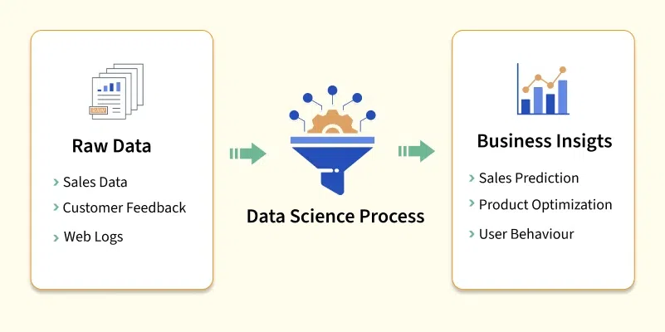
Basics – What is Data science
References:
https://medium.com/analytics-vidhya/introduction-to-data-science-28deb32878e7
https://www.ibm.com/think/topics/data-science
https://www.geeksforgeeks.org/data-science/
https://ischoolonline.berkeley.edu/data-science/what-is-data-science/
https://www.datacamp.com/blog/what-is-data-science-the-definitive-guide

Slide 14
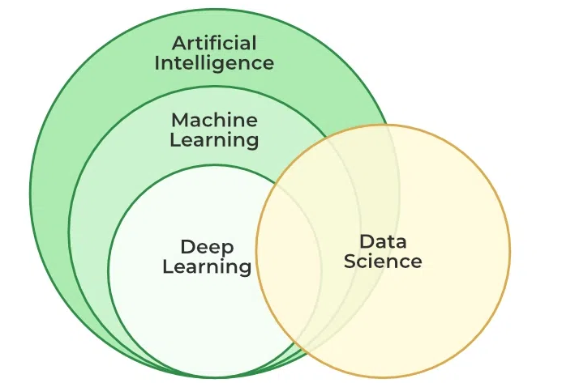
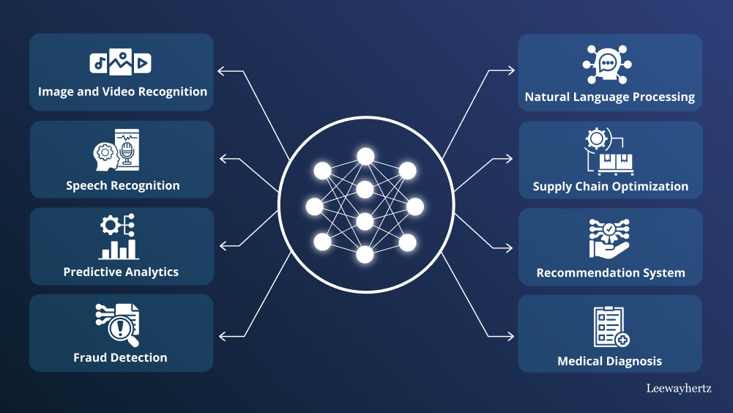
Big Picture –Applied Use Cases
Use Cases
Traffic signal – monitoring and schedule management
Traffic challan – signal break – speed limit monitoring system
Autonomous cars , self driving car - safe driving . Collision detection
M-Tag scan and deduction of fee – on ring road , motorway
Prescription on medical industry – based on machine learning
Legal support – for based on Law – rules and cases history
References:
https://cloud.google.com/discover/ai-applications?hl=en
https://www.ibm.com/think/topics/artificial-intelligence-business-use-cases
https://www.leewayhertz.com/ai-use-cases-and-applications/

Slide 15
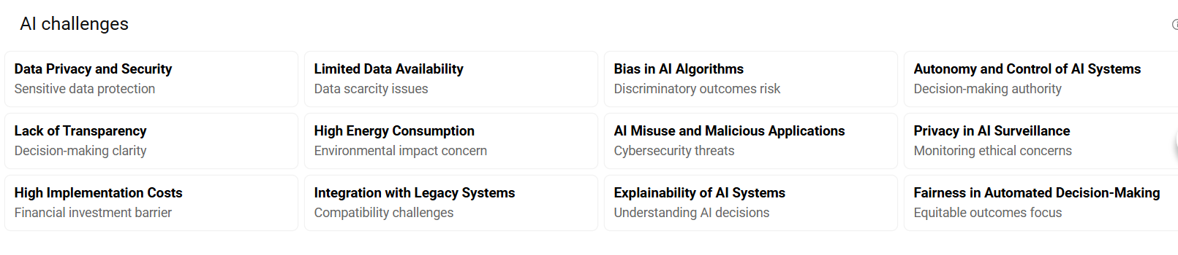
Challenges of AI
References:
https://www.simplilearn.com/challenges-of-artificial-intelligence-article
https://www.geeksforgeeks.org/top-challenges-for-artificial-intelligence/
https://www.upgrad.com/blog/top-challenges-in-artificial-intelligence/

Slide 16
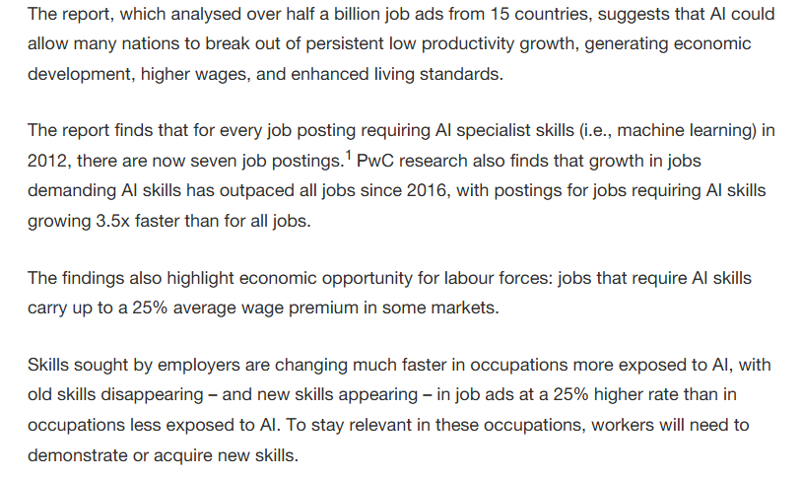
Your Professional Career – Why AI Important
References:
https://www.wgu.edu/blog/ai-careers-guide-jobs-artificial-intelligence2503.html
https://mitsloan.mit.edu/ideas-made-to-matter/why-future-ai-future-work
https://csuglobal.edu/blog/why-ai-important

Slide 17
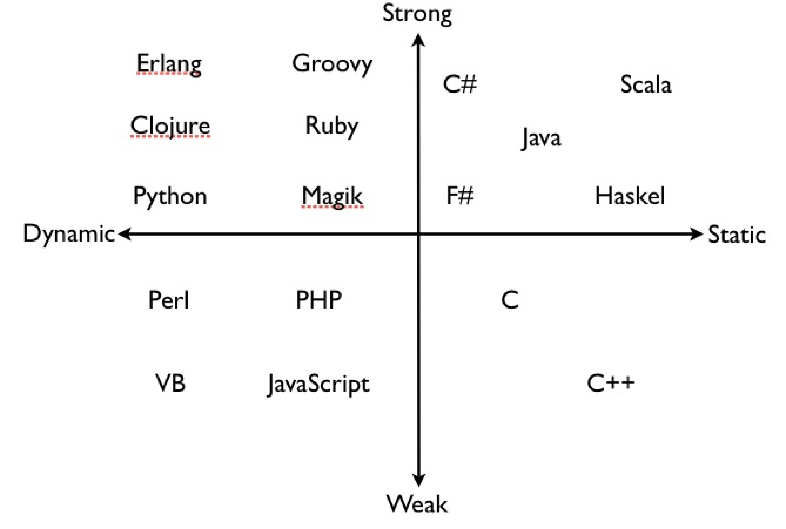
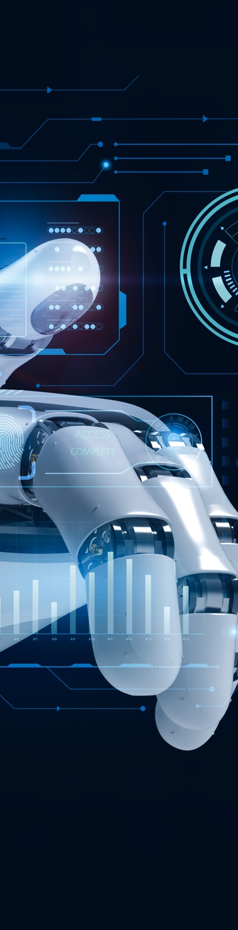
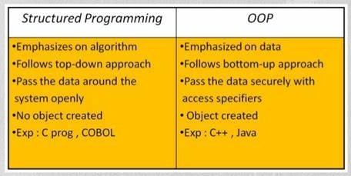
Development Background
Strongly typed vs weekly typed Programming languages
https://99x.io/europe/resources/blog/strongly-vs-weakly-typed-languages
https://www.linkedin.com/advice/0/what-difference-between-strongly-weakly-typed-eqwlc
https://medium.com/@fedor.selenskiy/static-dynamic-vs-strong-weak-typing-a-common-misconception-d050f24b7db9
Structured vs Object oriented - Programming Languages
https://www.geeksforgeeks.org/difference-between-structured-programming-and-object-oriented-programming/
https://dzone.com/articles/decoding-the-nuances-structured-vs-object-oriented
https://www.tutorialspoint.com/difference-between-structured-and-object-oriented-programming

Slide 18
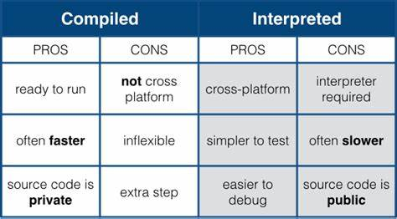
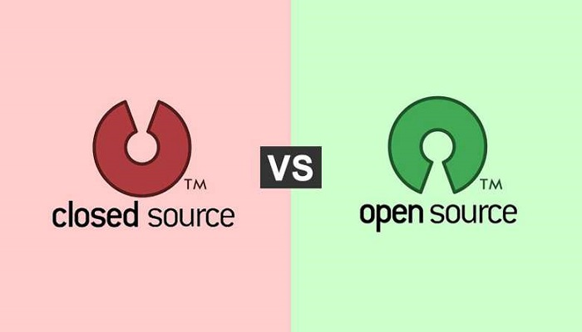
Development Background - 2
Compiled vs Interpreted Programming Languages
https://www.freecodecamp.org/news/compiled-versus-interpreted-languages/
https://www.geeksforgeeks.org/difference-between-compiled-and-interpreted-language/
https://byjus.com/gate/difference-between-compiled-and-interpreted-language/
Open Source vs Close source - Development / Culture
https://edu.gcfglobal.org/en/basic-computer-skills/open-source-vs-closed-source-software/1/
https://www.pingcap.com/article/open-source-vs-closed-source-software-benefits/
https://www.splunk.com/en_us/blog/learn/open-vs-closed-source-software.html
Open Source as business Strategy- example
Open Source – with custom build by each vendor. Foundation and its variant
M&A process – Company culture

Slide 19
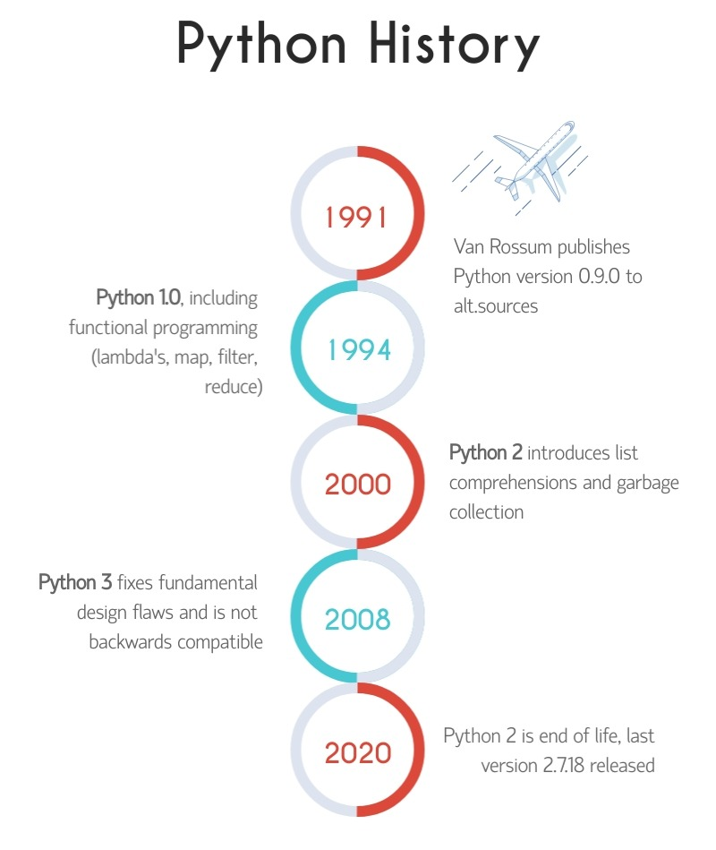
Development– The Python - Way
IDE: Visual Studio Code
IDE Extension: Python by Microsoft
Python version : 3.13.2
Source Code Repository : GitHub
Code Debugger: Build-in
System Requirements – how to find
Feature – Release notes
Known Issues
Using Google and LLMs
Resources:
https://wiki.python.org/moin/BeginnersGuide/Programmers

Slide 20
What is expected in this Course?
In-depth - Theoretical Foundation for AI / ML / DL
Python – deep dive as development platform – core development/programming stack
Development in NUMPY
Development in Pandas
Development in Seaborn
Development in Scikit-learn
Development in TensorFlow
Development in Keras
Machine Learning – Algorithm design, analysis , exploration, investigation and development
Deep Learning – Neutral Network - Algorithm design, analysis , exploration, investigation and development

Slide 21
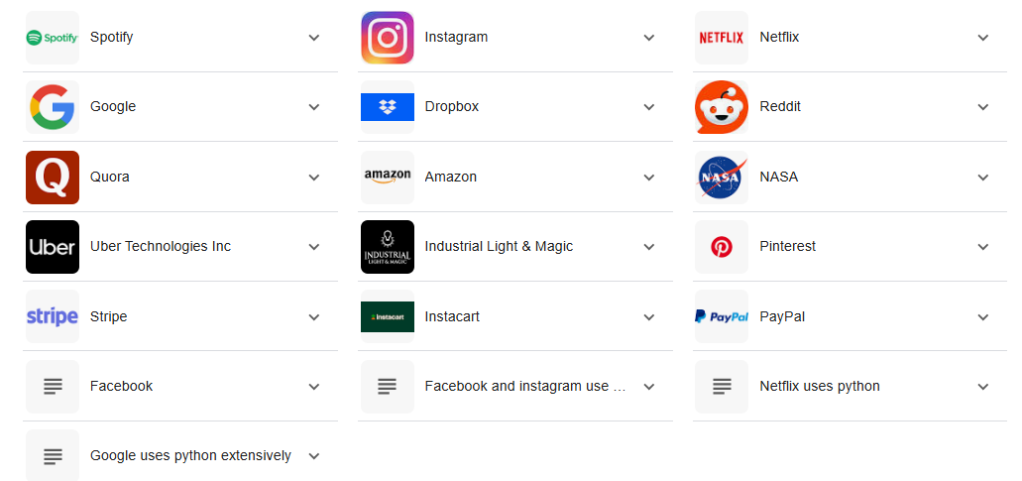
Which Global Companies Use Python?
References:
https://jaydevs.com/top-companies-that-use-python/
https://trio.dev/companies-using-python/
https://brainstation.io/career-guides/who-uses-python-today

Slide 22
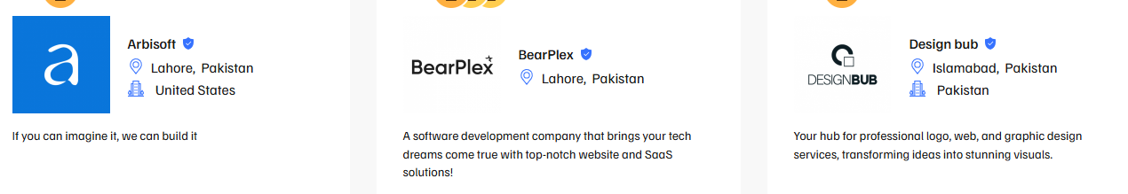
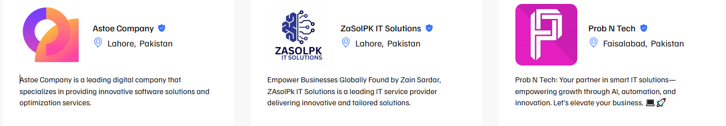
Which Software Houses in Pakistan- Use Python?
References:
https://techbehemoths.com/companies/python/pakistan
https://www.sortlist.com/s/python-development/pakistan-pk
https://superbcompanies.com/categories/python-development-companies-in-pakistan/
https://themanifest.com/pk/software-development/python-django/companies

Slide 23










Which Global Software Houses in Pakistan- Planning Big on AI?
https://systemsltd.com/services/generative-ai
https://systemsltd.com/services/advanced-analytics
https://www.xavor.com/ai-ml-solutions/
https://netsoltech.com/products/transcend-ai-labs
https://www.alphabold.com/solutions/artificial-intelligence/
https://arbisoft.com/solutions/data/generative-ai
https://arbisoft.com/solutions/data/deep-learning
https://arbisoft.com/solutions/data/machine-learning
https://arbisoft.com/solutions/data/science
https://nextbridge.com/ai-machine-learning/
https://nextbridge.com/computer-vision/
https://www.techlogix.com/data-analytics-ai/
https://northbaysolutions.com/services/generative-ai-ml/
https://www.afiniti.com/products/experienceai/

Slide 24
Career Orientation – Based on this – “Full Stack AI” course
BI Product oriented vs BI Neutral Career Strategy
Data science – Product oriented vs Data science Neutral Career Strategy
AI Product oriented vs AI Neutral Career Strategy
ML Product oriented vs ML Neutral Career Strategy
DL Product oriented vs DL Neutral Career Strategy
Employment vs Entrepreneurship strategy
Freelancing to company establishment
Freelancing – Upwork vs Fiverr
AI tools vs AI development stack
LLM based vertical trained – business model
On Premises VS On Cloud - AI – services Stacks
Confused…– Don’t be – Just focus on this “Full Stack AI” course
Small baby steps towards AI enabled Professional orientation
Prefer Iterations, progressiveness over Idealism and perfection
Not just theory, Practical / Programming / Development oriented AI approach
Join for – AL Full stack course – refine and redefine – your future
Will put your hands – into full scale AI development stack course
A baby bird in nest, will have to jump for the first time, with risk of falling – to Fly high in the
sky. Need to take risk, need to be bold , need to be brave to face the professional orientation challenges.

Slide 25
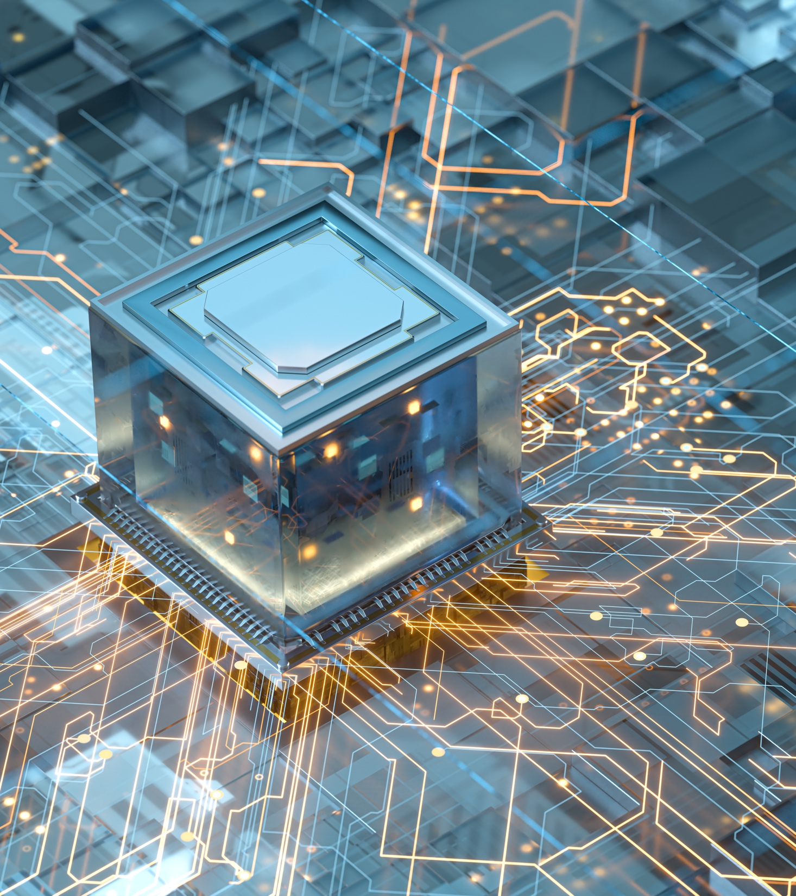
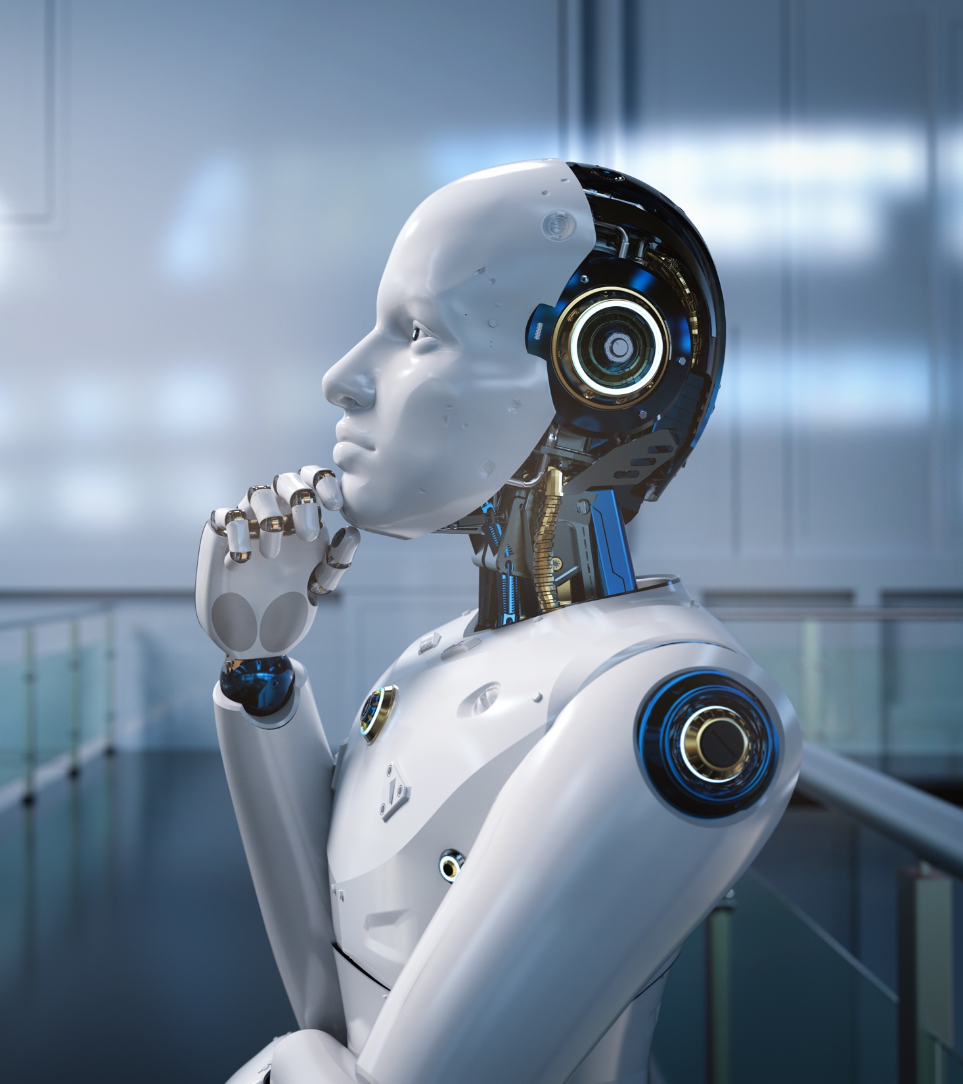
Shahzad Sarwar
Cognitive Convergence
https://cognitiveconvergence.com
Thank you - for listening
and participating
Questions / Queries
Suggestions/Recommendation
Ideas…..?
Movies about AI-Artificial Intelligence -Robots
https://www.imdb.com/list/ls500056453/
https://en.wikipedia.org/wiki/List_of_artificial_intelligence_films
https://www.top5.com/20-movies-about-artificial-intelligence-taking-over-the-world/
https://www.ranker.com/list/best-artificial-intelligence-movies-list/ranker-film

